Slide 1
CSC 2224: Parallel Computer Architecture and Programming Advanced Memory
Prof. Gennady Pekhimenko
University of Toronto
Fall 2019
The content of this lecture is adapted from the slides of
Vivek Seshadri, Yoongu Kim,
and lectures of Onur Mutlu @ ETH and CMU

Slide 2
Review #5
Flipping Bits in Memory Without Accessing Them Yoongu Kim et al., ISCA 2014

Slide 3
Review: Memory Latency Lags Behind
128x
20x
1.3x
Memory latency remains almost constant

Slide 4
We Need A Paradigm Shift To …
Enable computation with minimal data movement
Compute where it makes sense (where data resides)
Make computing architectures more data-centric

Slide 5
Processing Inside Memory
Many questions … How do we design the:
compute-capable memory & controllers?
processor chip?
software and hardware interfaces?
system software and languages?
algorithms?
Memory
Processor
Core
Database
Graphs
Media
Cache
Query
Interconnect
Problem
Results
Algorithm
Program/Language
System Software
SW/HW Interface
Micro-architecture
Logic
Devices
Electrons

Slide 6
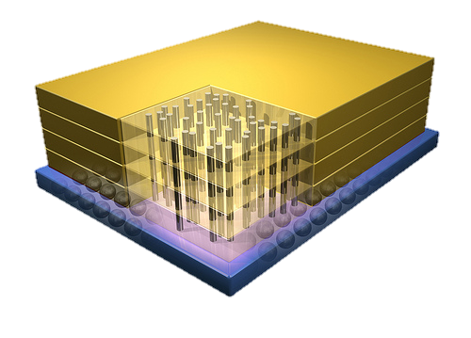
Why In-Memory Computation Today?
Dally, HiPEAC 2015
Push from Technology
DRAM Scaling at jeopardy
→ Controllers close to DRAM
→ Industry open to new memory architectures
Pull from Systems and Applications
Data access is a major system and application bottleneck
Systems are energy limited
Data movement much more energy-hungry than computation

Slide 7
Two Approaches to In-Memory Processing
1. Minimally change DRAM to enable simple yet powerful computation primitives
RowClone: Fast and Efficient In-DRAM Copy and Initialization of Bulk Data (Seshadri et al., MICRO 2013)
Fast Bulk Bitwise AND and OR in DRAM (Seshadri et al., IEEE CAL 2015)
Gather-Scatter DRAM: In-DRAM Address Translation to Improve the Spatial Locality of Non-unit Strided Accesses (Seshadri et al., MICRO 2015)
2. Exploit the control logic in 3D-stacked memory to enable more comprehensive computation near memory
PIM-Enabled Instructions: A Low-Overhead, Locality-Aware Processing-in-Memory Architecture (Ahn et al., ISCA 2015)
A Scalable Processing-in-Memory Accelerator for Parallel Graph Processing (Ahn et al., ISCA 2015)
Accelerating Pointer Chasing in 3D-Stacked Memory: Challenges, Mechanisms, Evaluation (Hsieh et al., ICCD 2016)

Slide 8
Approach 1: Minimally Changing DRAM
DRAM has great capability to perform bulk data movement and computation internally with small changes
Can exploit internal bandwidth to move data
Can exploit analog computation capability
…
Examples: RowClone, In-DRAM AND/OR, Gather/Scatter DRAM
RowClone: Fast and Efficient In-DRAM Copy and Initialization of Bulk Data (Seshadri et al., MICRO 2013)
Fast Bulk Bitwise AND and OR in DRAM (Seshadri et al., IEEE CAL 2015)
Gather-Scatter DRAM: In-DRAM Address Translation to Improve the Spatial Locality of Non-unit Strided Accesses (Seshadri et al., MICRO 2015)

Slide 9
Starting Simple: Data Copy and Initialization
Bulk Data Copy
src
dst
Bulk Data Initialization
dst
val

Slide 10
Bulk Data Copy and Initialization
Bulk Data Copy
src
dst
Bulk Data Initialization
dst
val

Slide 11
Bulk Data Copy and Initialization
memmove & memcpy: 5% cycles in Google’s datacenter [Kanev+ ISCA’15]
000000000000000
Zero initialization
(e.g., security)
Forking
Checkpointing
Many more
VM Cloning
Deduplication
Page Migration

Slide 12
Today’s Systems: Bulk Data Copy
1) High latency
Memory
3) Cache pollution
L3
CPU
L2
L1
MC
2) High bandwidth utilization
4) Unwanted data movement
1046ns, 3.6uJ (for 4KB page copy via DMA)

Slide 13
Future Systems: In-Memory Copy
3) No cache pollution
1) Low latency
Memory
L3
CPU
L2
L1
MC
2) Low bandwidth utilization
4) No unwanted data movement
1046ns, 3.6uJ
→ 90ns, 0.04uJ

Slide 14
RowClone: In-DRAM Row Copy
Idea: Two consecutive ACTivates
4 Kbytes
Negligible HW cost
Step 1: Activate row A
Step 2: Activate row B
Transfer row
DRAM subarray
Transfer
row
Row Buffer (4 Kbytes)
8 bits
Data Bus
Notes:
copy

Slide 15
RowClone: Intra-Subarray
V_{DD}
V_{DD}/2 + δ
V_{DD}
V_{DD}/2
V_{DD}/2 + δ
src
0
dst
0
Amplify the difference
Data gets copied
Sense Amplifier
(Row Buffer)
V_{DD}/2
0

Slide 16
RowClone: Intra-Subarray (II)
s
r
c
r
o
w
s
d
s
r
c
t
r
r
o
o
w
w
s
r
c
r
o
w
Row Buffer
1. Activate src row (copy data from src to row buffer)
2. Activate dst row (disconnect src from row buffer, connect dst – copy data from row buffer to dst)

Slide 17
RowClone: Inter-Bank
Chip I/O
Bank
Shared internal bus
Memory Channel
Overlap the latency of the read and the write
1.9X latency reduction, 3.2X energy reduction

Slide 18
Generalized RowClone
0.01% area cost
Inter Subarray Copy
(Use Inter-Bank Copy Twice)
Subarray
Chip I/O
Bank
Bank I/O
Memory Channel
Inter Bank Copy
(Pipelined
Internal RD/WR)
Intra Subarray
Copy (2 ACTs)

Slide 19
RowClone: Fast Row Initialization
0
0
0
0
0
0
0
0
0
0
0
0
Fix a row at Zero
(0.5% loss in capacity)

Slide 20
RowClone: Bulk Initialization
Initialization with arbitrary data
Initialize one row
Copy the data to other rows
Zero initialization (most common)
Reserve a row in each subarray (always zero)
Copy data from reserved row (FPM mode)
6.0X lower latency, 41.5X lower DRAM energy
0.2% loss in capacity

Slide 21
RowClone: Latency & Energy Benefits
74.4x
11.6x
41.5x
6.0x
1.9x
1.0x
3.2x
1.5x
Very low cost: 0.01% increase in die area

Slide 22
Copy and Initialization in Workloads

Slide 23
RowClone: Application Performance

Slide 24
End-to-End System Design
Application
How to communicate occurrences of bulk copy/initialization across layers?
Operating System
How to ensure cache coherence?
ISA
Microarchitecture
How to maximize latency and energy savings?
DRAM (RowClone)
How to handle data reuse?

Slide 25
Ambit In-Memory Accelerator for Bulk Bitwise Operations Using Commodity DRAM Technology
Vivek Seshadri
Donghyuk Lee, Thomas Mullins, Hasan Hassan, Amirali Boroumand, Jeremie Kim, Michael A. Kozuch, Onur Mutlu, Phillip B. Gibbons, Todd C. Mowry

Slide 26
Executive Summary
Problem: Bulk bitwise operations
present in many applications, e.g., databases, search filters
existing systems are memory bandwidth limited
Our Proposal: Ambit
perform bulk bitwise operations completely inside DRAM
bulk bitwise AND/OR: simultaneous activation of three rows
bulk bitwise NOT: inverters already in sense amplifiers
less than 1% area overhead over existing DRAM chips
Results compared to state-of-the-art baseline
average across seven bulk bitwise operations
32X performance improvement, 35X energy reduction
3X-7X performance for real-world data-intensive applications
Notes:
Talk about energy more
Explicitly state the performance improvement numbers
Range for throughput and energy?
Color more? Bulk AND/OR or NOT
Mechanism for NOT – fix the description. (use inverters already in sense amplifiers}?
Cost not coming out – mention the area cost

Slide 27
BitWeaving
(database queries)
Bitmap indices
(database indexing)
BitFunnel
(web search)
Bulk Bitwise Operations
Set operations
DNA
sequence mapping
Encryption algorithms
...
[1] Li and Patel, BitWeaving, SIGMOD 2013
[2] Goodwin+, BitFunnel, SIGIR 2017
Notes:
Add … (signify more applications)
Add references to some works (bitweaving, bitfunnel)

Slide 28
Today, DRAM is just a storage device!
DRAM
Write
Processor
(CPU, GPU, FPGA)
Channel
Read
Throughput of bulk bitwise operations limited by available memory bandwidth

Slide 29
Our Approach
DRAM
Processor
(CPU, GPU, FPGA or PiM)
Channel
Use analog operation of DRAM to perform bitwise operations completely inside memory!

Slide 30
Inside a DRAM Chip
…
…
…
…
2D Array
of DRAM Cells
…
…
Sense amplifiers
8KB

Slide 31
DRAM Cell Operation
wordline
capacitor
bitline
access transistor
Sense Amp
enable
bitline

Slide 32
DRAM Cell Operation
deviation in bitline voltage
raise wordline
wordline
1
0
½ V_{DD} + δ
½ V_{DD}
V_{DD}
capacitor
bitline
access transistor
connects cell to bitline
cell regains charge
cell loses charge to bitline
Sense Amp
1
0
enable sense amp
enable
bitline
½ V_{DD}
0

Slide 33
Triple-Row Activation: Majority Function
1
V_{DD}
½ V_{DD} + δ
0
½ V_{DD}
activate
all three rows
1
0
1
0
Sense Amp
1
0
enable sense amp

Slide 34
Bitwise AND/OR Using Triple-Row Activation
1
V_{DD}
A
1
B
1
C
Sense Amp
1

Slide 35
Bitwise AND/OR Using Triple-Row Activation
1
V_{DD}
A
Output = AB + BC + CA
= C (A OR B) +
~C (A AND B)
1
B
1
Control the value of C to perform bitwise OR or bitwise AND of A and B
C
38X improvement in raw throughput
44X reduction in energy consumption
for bulk bitwise AND/OR operations
Sense Amp
1

Slide 36
Bulk Bitwise AND/OR in DRAM
Statically reserve three designated rows t1, t2, and t3
Result = row A AND/OR row B
Copy data of row A to row t1
Copy data of row B to row t2
Initialize data of row t3 to 0/1
Activate rows t1/t2/t3 simultaneously
Copy data of row t1/t2/t3 to Result row
Copy data of row A to row t1
Copy data of row B to row t2
Initialize data of row t3 to 0/1
Activate rows t1/t2/t3 simultaneously
Copy data of row t1/t2/t3 to Result row
MICRO 2013
Notes:
* each copy operation takes only 80ns

Slide 37
Bulk Bitwise AND/OR in DRAM
Statically reserve three designated rows t1, t2, and t3
Result = row A AND/OR row B
Copy RowClone data of row A to row t1
Copy RowClone data of row B to row t2
Initialize RowClone data of row t3 to 0/1
Activate rows t1/t2/t3 simultaneously
Copy RowClone data of row t1/t2/t3 to Result row
Copy data of row A to row t1
Copy data of row B to row t2
Initialize data of row t3 to 0/1
Activate rows t1/t2/t3 simultaneously
Copy data of row t1/t2/t3 to Result row
Use RowClone to perform copy and initialization operations completely in DRAM!
Notes:
Replace copies with rowclone once it is mentioned
Tie back to the concerns.
Reiterate speedup numbers
strike copy and make it rowclone

Slide 38
Negation Using the Sense Amplifier
Can we copy the negated value from bitline to a DRAM cell?
bitline
Sense Amp
enable
bitline
Notes:
Mark the enable signal to the sense amplifier
Before introducing the dual contact cell, state the key idea

Slide 39
Negation Using the Sense Amplifier
Dual Contact Cell
Regular wordline
Negation wordline
bitline
Sense Amp
enable
bitline
Notes:
Mark the enable signal to the sense amplifier
Before introducing the dual contact cell, state the key idea

Slide 40
Negation Using the Sense Amplifier
V_{DD}
½ V_{DD} + δ
activate source
½ V_{DD}
source
activate
negation wordline
bitline
Sense Amp
enable sense amp
½ V_{DD}
0
bitline
Notes:
Provide the result for NOT
Present all the results after this slide?

Slide 41
Ambit vs. DDR3: Performance and Energy
32X
35X

Slide 42
Integrating Ambit with the System
PCIe device
Similar to other accelerators (e.g., GPU)
System memory bus
Ambit uses the same DRAM command/address interface
Pros and cons discussed in paper
(Section 5.4)
Notes:
Make it simpler
Two approaches.

Slide 43
Real-world Applications
Methodology (Gem5 simulator)
Processor: x86, 4 GHz, out-of-order, 64-entry instruction queue
L1 cache: 32 KB D-cache and 32 KB I-cache, LRU policy
L2 cache: 2 MB, LRU policy
Memory controller: FR-FCFS, 8 KB row size
Main memory: DDR4-2400, 1 channel, 1 rank, 8 bank
Workloads
Database bitmap indices
BitWeaving –column scans using bulk bitwise operations
Set operations – comparing bitvectors with red-black trees
Notes:
Add color
Fix workloads – add set operation workload as well

Slide 44
Bitmap Indices: Performance
6.6X
6.2X
6.3X
5.7X
6.1X
5.4X
Consistent reduction in execution time. 6X on average
Notes:
Add color
Remove “week” and “users”

Slide 45
Speedup offered by Ambit for BitWeaving
select count(*) where c1 < field < c2
Number of rows in the database table
12X
Notes:
Reference bitweaving again
Add color
Fix the tag

Slide 46
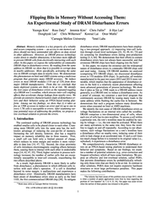
FLIPPING BITS IN MEMORY WITHOUT ACCESSING THEM ISCA 2014
ROW HAMMER

Slide 47
DRAM CHIP
WORDLINE
VICTIM
AGGRESSOR
ROW
LOW VOLTAGE
HIGH VOLTAGE
VICTIM
READ DATA FROM HERE, GET ERRORS OVER THERE

Slide 48
GOOGLE’S EXPLOIT
“We learned about rowhammer from Yoongu Kim et al.”
http://googleprojectzero.blogspot.com

Slide 49
GOOGLE’S EXPLOIT
OUR PROOF-OF-CONCEPT
EMPIRICAL ANALYSIS
PROPOSED SOLUTIONS

Slide 50
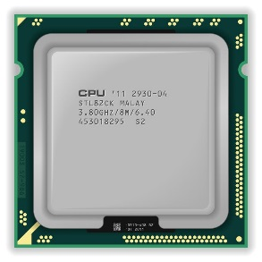
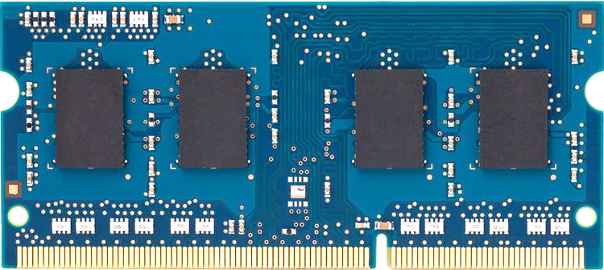
REAL SYSTEM
MANY READS TO SAME ADDRESS
≠
OPEN/CLOSE SAME ROW
x86
DRAM
1. CACHE HITS
2. ROW HITS

Slide 51
x86 CPU
DRAM
LOOP:
mov (X), %reg
mov (Y), %reg
clflush (X)
clflush (Y)
jmp LOOP
X
11111111111
1111
11111111111
11011110010
11111111111
11111111111
10111010111
Y
11111111111
1111
MANY ERRORS!
http://www.github.com/CMU-SAFARI/rowhammer

Slide 52
WHY DO THE ERRORS OCCUR?

Slide 53
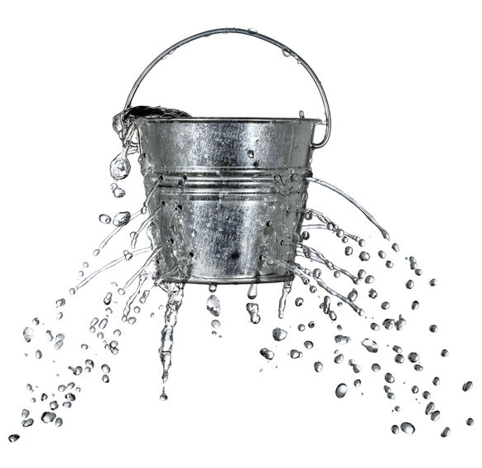
DRAM CELLS ARE LEAKY
‘1’
NORMAL CELL
CHARGE
REFRESH
‘0’
0ms
TIME
64ms

Slide 54
DRAM CELLS ARE LEAKY
AGGRESSOR
‘1’
REFRESH
CHARGE
‘0’
VICTIM CELL
0ms
TIME
64ms

Slide 55
ROOT CAUSE?
COUPLING
Electromagnetic
Tunneling
⇝
⇝
⇝
⇝
⇝
⇝
⇝
⇝
ACCELERATES CHARGE LOSS

Slide 56
AS DRAM SCALES …
CELLS BECOME SMALLER Less tolerance to coupling effects
CELLS BECOME PLACED CLOSER Stronger coupling effects
COUPLING ERRORS MORE LIKELY

Slide 57
ERRORS ARE RECENT Not found in pre-2010 chips
ERRORS ARE WIDESPREAD >80% of chips have errors Up to one error per ~1K cells

Slide 58
PC
FPGA
Test Engine
PCIe
DRAM Ctrl
DRAM

Slide 59
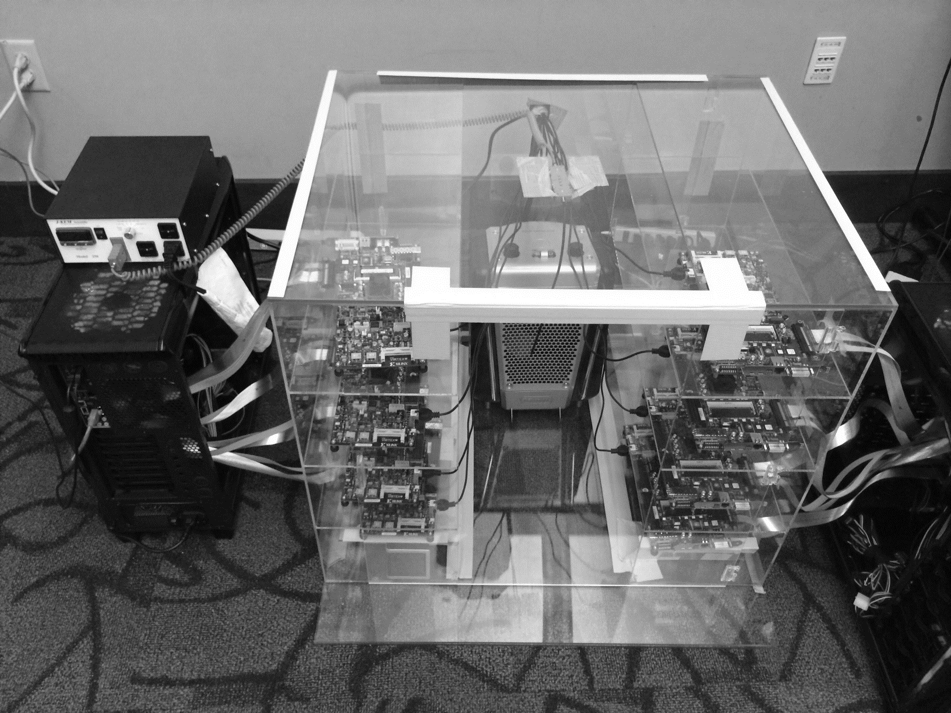
Temperature
Controller
FPGAs
Heater
FPGAs
PC

Slide 60
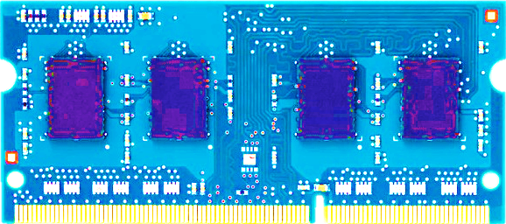
MOST MODULES AT RISK
A VENDOR
86%
(37/43)
B VENDOR
83%
(45/54)
C VENDOR
88%
(28/32)

Slide 61
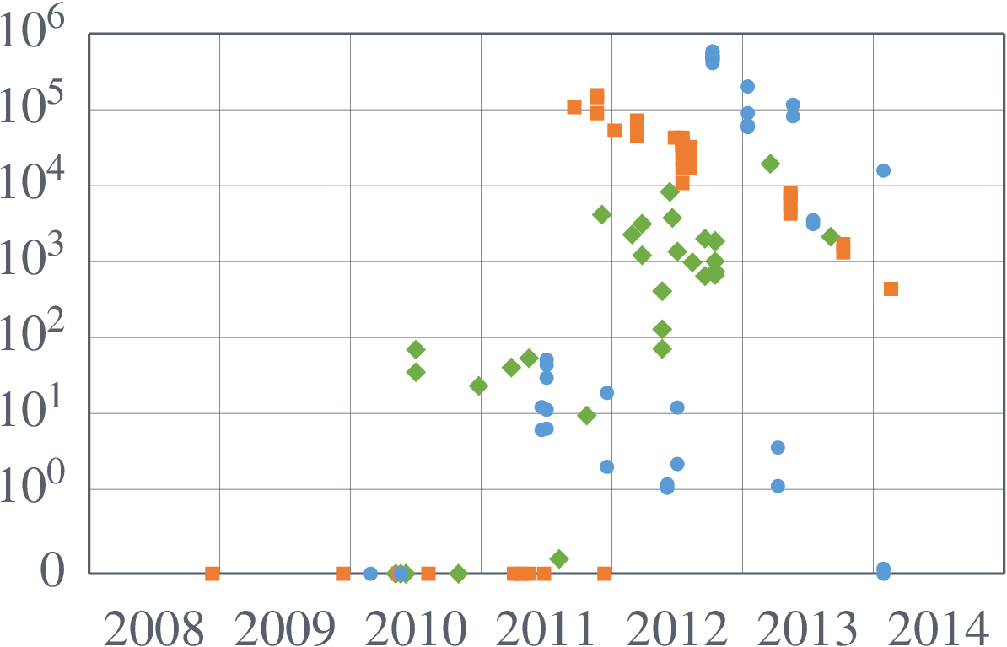
MODULES:  A  B  C
ERRORS PER 10⁹ CELLS
MANUFACTURE DATE

Slide 62
DISTURBING FACTS
AFFECTS ALL VENDORS Not an isolated incident Deeper issue in DRAM scaling
UNADDRESSED FOR YEARS Could impact systems in the field

Slide 63
HOW TO PREVENT COUPLING ERRORS?
Previous Approaches
1. Make Better Chips: Expensive
2. Rigorous Testing: Takes Too Long

Slide 64
ROW
FASTER ACCESS
MORE ERRORS
ROW
MORE ERRORS
ROW
ROW
FREQUENT REFRESH
FEWER ERRORS
ROW
FEWER ERRORS
ROW

Slide 65
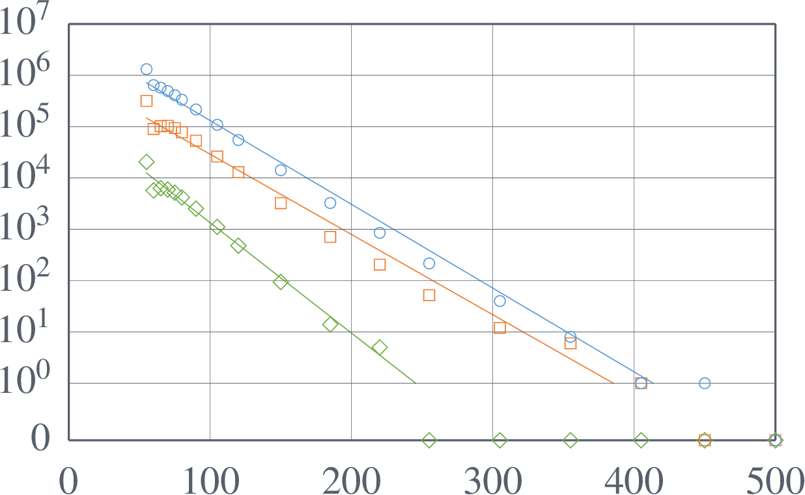
ONE MODULE:  A  B  C
Faster ⟶ Slower
$$\frac{\text{64}\text{ms}}{5\text{00}\text{ns}}=128K$$
TOTAL ERRORS
55ns
500ns
ACCESS INTERVAL (ns)

Slide 66
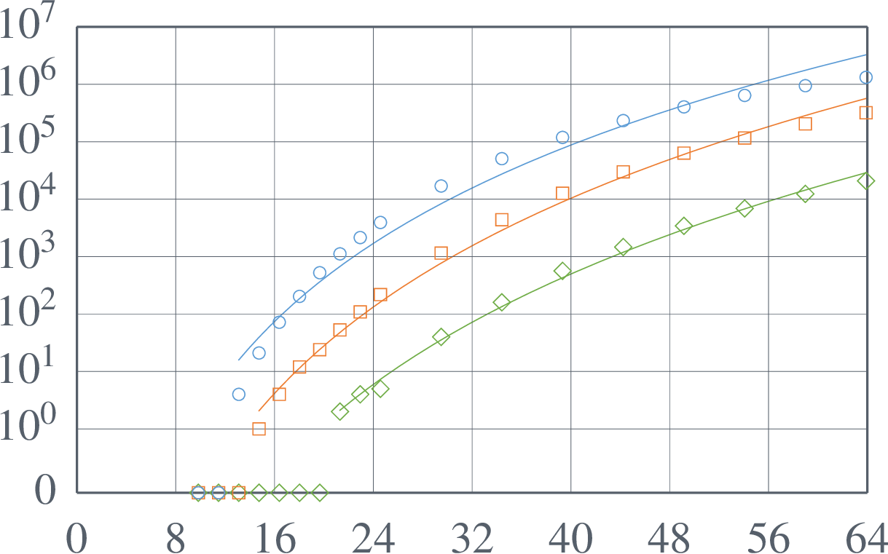
ONE MODULE:  A  B  C
Often ⟵ Seldom
$$\frac{\text{11}\text{ms}}{5\text{5}\text{ns}}=200K$$
TOTAL ERRORS
11ms
64ms
REFRESH INTERVAL (ms)

Slide 67
TWO NAIVE SOLUTIONS
LIMIT ACCESSES TO ROW Access Interval > 500ns
REFRESH ALL ROWS OFTEN Refresh Interval < 11ms
LARGE OVERHEAD: PERF, ENERGY, COMPLEXITY

Slide 68
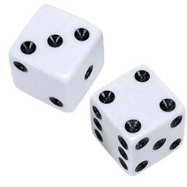
OUR SOLUTION: PARR
Probabilistic Adjacent Row Refresh
After closing any row ...
99.9%
0.1%
Do nothing
Refresh (=Open) adjacent rows

Slide 69
PARR: CHANCE OF ERROR
NO REFRESHES IN N TRIALS Probability: 0.999^{N}
N=128K FOR ERROR (64ms) Probability: 0.999^{128K} = 10^{–56}
STRONG RELIABILITY GUARANTEE

Slide 70
STRONG RELIABILITY
9.4×10^{–14} Errors/Year
LOW PERF OVERHEAD
0.20% Slowdown
NO STORAGE OVERHEAD
0 Bytes

Slide 71
RELATED WORK
Security Exploit (Seaborn@Google 2015)
Industry Analysis (Kang@SK Hynix 2014) “... will be [more] severe as technology shrinks down.”
Targeted Row Refresh (JEDEC 2014)
DRAM Testing (e.g., Van de Goor+ 1999)
Disturbance in Flash & Hard Disk

Slide 72
Emerging Memory Technologies

Slide 73
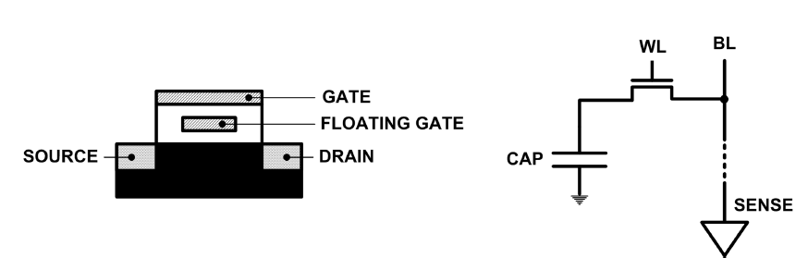
Limits of Charge Memory
Difficult charge placement and control
Flash: floating gate charge
DRAM: capacitor charge, transistor leakage
Reliable sensing becomes difficult as charge storage unit size reduces

Slide 74
Charge vs. Resistive Memories
Charge Memory (e.g., DRAM, Flash)
Write data by capturing charge Q
Read data by detecting voltage V
Resistive Memory (e.g., PCM, STT-MRAM, memristors)
Write data by pulsing current dQ/dt
Read data by detecting resistance R

Slide 75
Promising Resistive Memory Technologies
PCM
Inject current to change material phase
Resistance determined by phase
STT-MRAM
Inject current to change magnet polarity
Resistance determined by polarity
Memristors/RRAM/ReRAM
Inject current to change atomic structure
Resistance determined by atom distance

Slide 76
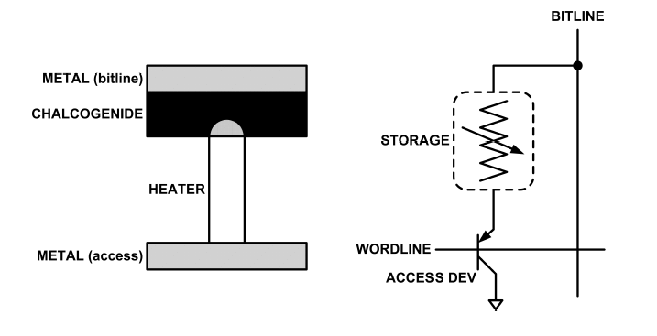
What is Phase Change Memory?
Phase change material (chalcogenide glass) exists in two states:
Amorphous: Low optical reflexivity and high electrical resistivity
Crystalline: High optical reflexivity and low electrical resistivity
PCM is resistive memory: High resistance (0), Low resistance (1)
PCM cell can be switched between states reliably and quickly

Slide 77
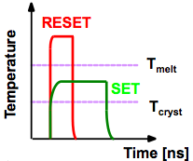
How Does PCM Work?
Write: change phase via current injection
SET: sustained current to heat cell above Tcryst
RESET: cell heated above Tmelt and quenched
Read: detect phase via material resistance
amorphous/crystalline
Large
Current
Small
Current
Memory
Element
SET (cryst)
Low resistance
Access
Device
RESET (amorph)
High resistance
10³-10⁴ Ω
10⁶-10⁷ Ω
Photo Courtesy: Bipin Rajendran, IBM
Slide Courtesy: Moinuddin Qureshi, IBM

Slide 78
Opportunity: PCM Advantages
Scales better than DRAM, Flash
Requires current pulses, which scale linearly with feature size
Expected to scale to 9nm (2022 [ITRS])
Prototyped at 20nm (Raoux+, IBM JRD 2008)
Can be denser than DRAM
Can store multiple bits per cell due to large resistance range
Prototypes with 2 bits/cell in ISSCC’08, 4 bits/cell by 2012
Non-volatile
Retain data for >10 years at 85C
No refresh needed, low idle power

Slide 79
PCM Resistance → Value
1
0
Cell value:
Cell resistance

Slide 80
Multi-Level Cell PCM
Multi-level cell: more than 1 bit per cell
Further increases density by 2 to 4x [Lee+,ISCA'09]
But MLC-PCM also has drawbacks
Higher latency and energy than single-level cell PCM

Slide 81
MLC-PCM Resistance → Value
Bit 1
Bit 0
1
1
1
0
0
1
0
0
Cell value:
Cell resistance

Slide 82
MLC-PCM Resistance → Value
Less margin between values
→ need more precise sensing/modification of cell contents
→ higher latency/energy (~2x for reads and 4x for writes)
1
1
1
0
0
1
0
0
Cell value:
Cell resistance

Slide 83
Phase Change Memory Properties
Surveyed prototypes from 2003-2008 (ITRS, IEDM, VLSI, ISSCC)
Derived PCM parameters for F=90nm
Lee, Ipek, Mutlu, Burger, “Architecting Phase Change Memory as a Scalable DRAM Alternative,” ISCA 2009.
Lee et al., “Phase Change Technology and the Future of Main Memory,” IEEE Micro Top Picks 2010.

Slide 84
Phase Change Memory Properties: Latency
Latency comparable to, but slower than DRAM
Read Latency
50ns: 4x DRAM, 10⁻³x NAND Flash
Write Latency
150ns: 12x DRAM
Write Bandwidth
5-10 MB/s: 0.1x DRAM, 1x NAND Flash
Qureshi+, “Scalable high performance main memory system using phase-change memory technology,” ISCA 2009.

Slide 85
Phase Change Memory Properties
Dynamic Energy
40 uA Rd, 150 uA Wr
2-43x DRAM, 1x NAND Flash
Endurance
Writes induce phase change at 650C
Contacts degrade from thermal expansion/contraction
10⁸ writes per cell
10⁻⁸x DRAM, 10³x NAND Flash
Cell Size
9-12F² using BJT, single-level cells
1.5x DRAM, 2-3x NAND (will scale with feature size, MLC)

Slide 86
Phase Change Memory: Pros and Cons
Pros over DRAM
Better technology scaling (capacity and cost)
Non volatile → Persistent
Low idle power (no refresh)
Cons
Higher latencies: ~4-15x DRAM (especially write)
Higher active energy: ~2-50x DRAM (especially write)
Lower endurance (a cell dies after ~10⁸ writes)
Reliability issues (resistance drift)
Challenges in enabling PCM as DRAM replacement/helper:
Mitigate PCM shortcomings
Find the right way to place PCM in the system

Slide 87
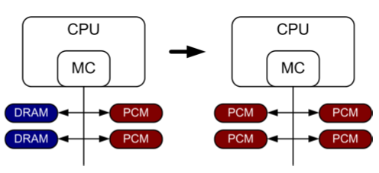
PCM-based Main Memory (I)
How should PCM-based (main) memory be organized?
Hybrid PCM+DRAM [Qureshi+ ISCA’09, Dhiman+ DAC’09]:
How to partition/migrate data between PCM and DRAM

Slide 88
PCM-based Main Memory (II)
How should PCM-based (main) memory be organized?
Pure PCM main memory [Lee et al., ISCA’09, Top Picks’10]:
How to redesign entire hierarchy (and cores) to overcome PCM shortcomings

Slide 89
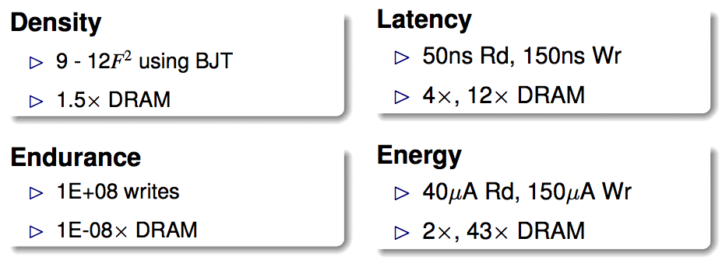
An Initial Study: Replace DRAM with PCM
Lee, Ipek, Mutlu, Burger, “Architecting Phase Change Memory as a Scalable DRAM Alternative,” ISCA 2009.
Surveyed prototypes from 2003-2008 (e.g. IEDM, VLSI, ISSCC)
Derived “average” PCM parameters for F=90nm

Slide 90
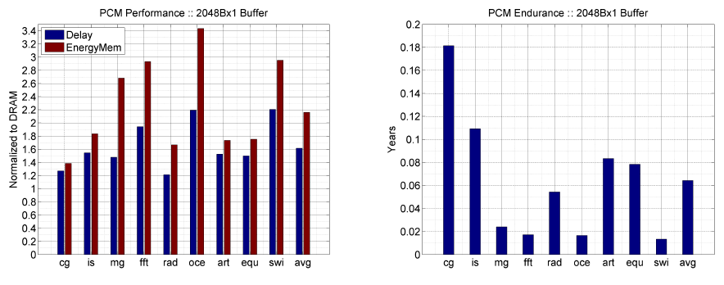
Results: Naïve Replacement of DRAM with PCM
Replace DRAM with PCM in a 4-core, 4MB L2 system
PCM organized the same as DRAM: row buffers, banks, peripherals
1.6x delay, 2.2x energy, 500-hour average lifetime
Lee, Ipek, Mutlu, Burger, “Architecting Phase Change Memory as a Scalable DRAM Alternative,” ISCA 2009.

Slide 91
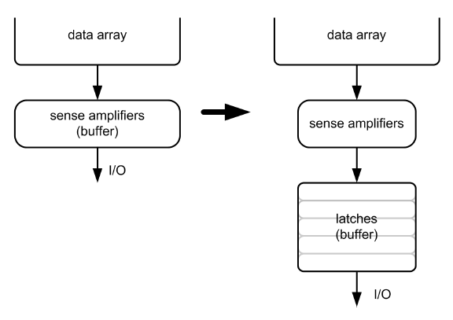
Architecting PCM to Mitigate Shortcomings
Idea 1: Use multiple narrow row buffers in each PCM chip
→ Reduces array reads/writes → better endurance, latency, energy
Idea 2: Write into array at
cache block or word
granularity
→ Reduces unnecessary wear
DRAM
PCM

Slide 92
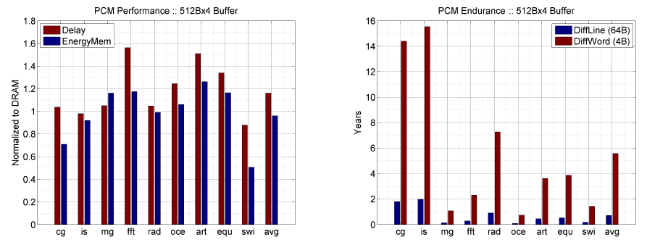
Results: Architected PCM as Main Memory
1.2x delay, 1.0x energy, 5.6-year average lifetime
Scaling improves energy, endurance, density
Caveat 1: Worst-case lifetime is much shorter (no guarantees)
Caveat 2: Intensive applications see large performance and energy hits
Caveat 3: Optimistic PCM parameters?

Slide 93
PCM As Main Memory
Benjamin C. Lee, Engin Ipek, Onur Mutlu, and Doug Burger, "Architecting Phase Change Memory as a Scalable DRAM Alternative" Proceedings of the 36th International Symposium on Computer Architecture (ISCA), pages 2-13, Austin, TX, June 2009. Slides (pdf)

Slide 94
Review #5
Flipping Bits in Memory Without Accessing Them Yoongu Kim et al., ISCA 2014

Slide 95
CSC 2224: Parallel Computer Architecture and Programming Advanced Memory
Prof. Gennady Pekhimenko
University of Toronto
Fall 2019
The content of this lecture is adapted from the slides of
Vivek Seshadri, Yoongu Kim,
and lectures of Onur Mutlu @ ETH and CMU

